Slide 1
Hierarchical Context Enabled Recurrent Neural Network for Recommendation
Group No - 25
Kazi Shahed Mamun- 20301471
ST - Abid Hossain
RA - Sania Azhmee Bhuiyan

Slide 2
Introduction
Recommendations are based on the assumption that a user's interests can vary hierarchically: General interest, Local context and Temporary context.
These hierarchical interest dynamics are categorized into three contexts: Global context, Local context and Temporary context.
The passage mentions two models, NARM and STAMP, that address these hierarchical contexts in user recommendation.
NARM focuses on modelling the general interest. STAMP predicts the next item by considering temporary contexts.

Slide 3
Dataset
Three publicly available datasets were used: CiteULike, LastFM, and MovieLens1
The focus is on modelling long user histories, so sequences with fewer than 10 items were removed and those that appeared infrequently were also removed.
Cross-validation was performed, with 10% of randomly chosen training data used as a validation set.
Data augmentation techniques, similar to those proposed in NARM and improved GRU4REC, were applied to reduce overfitting.

Slide 4
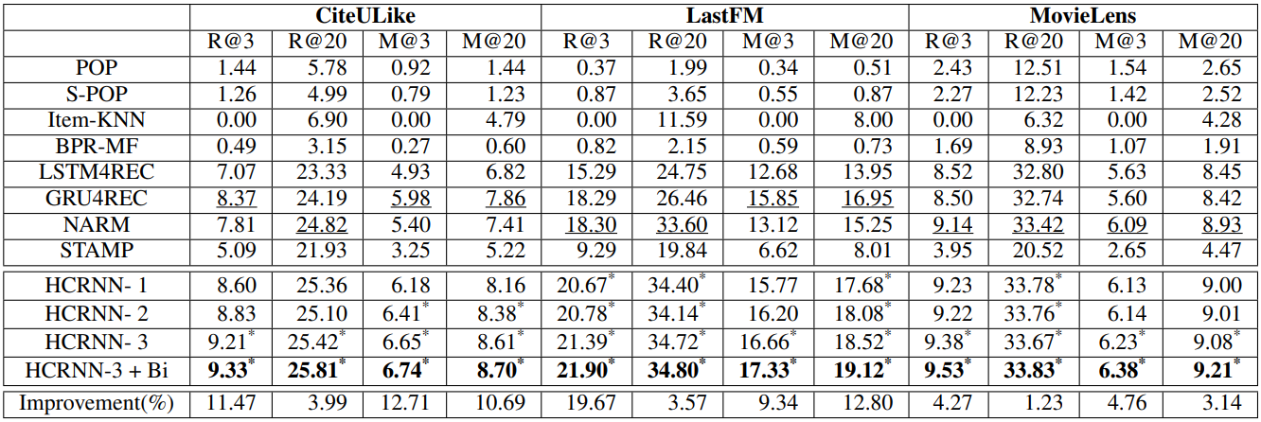
Results
The variations of HCRNN consistently outperform baselines and exhibit significant performance improvements across all datasets and metrics.
Also outperforms RNN-based recommendations like NARM, GRU4REC, and LSTM4REC, indicating that the modified HCRNN cell contributes to performance improvements.
The presence of a drift gate in HCRNN-3, denoted as G(d)t, leads to better results, supporting the experimental justification of the interest drift assumption.
NARM, which uses RNN and attention, performs better than STAMP, which uses a feedforward neural network, emphasizing the importance of sequential modelling for recommendations with long sequences.
Table 1: Performance evaluation of the proposed models.

Slide 5
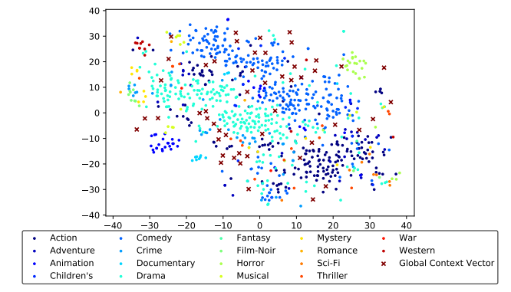
Results
Figure 1 presents a joint visualization of item embeddings and the global context memory. Item embeddings are organized into cohesive clusters with similar genres, while the global context memory covers the area where item embeddings are dispersed.
Local context is derived from global context memory, and temporary context is generated based on the previous temporary context and the current item embedding (xt). The first analysis involves visualizing Global Context Memory and item embedding (xt) to assess the quality of inputs for constructing local context (ct) and temporary context (ht).
Fig 1. Item embedding and global context vector
(Item embedding is interpretable with genre, and global context vector cover the most of the items)

Slide 6
Conclusion
The paper introduces HCRNN, a model designed to handle hierarchical contexts in recommendation systems.
HCRNN distinguishes between temporary contexts and local contexts, enabling the temporary context to focus on current items and transient user interests.
To effectively model hierarchical contexts, a novel context generation structure is proposed, which combines the benefits of latent topic models and memory networks to capture abstract information for both global and local contexts.
A new gate mechanism is introduced to incorporate the assumption of interest drift.
To support HCRNN in dealing with hierarchical contexts, the paper suggests the use of bi-channel attentions. These attentions address both long-term dependencies and recent user interests in the extended user history.

